Slide 1

ECHO MUSIC PLAYER
Project Synopsis Presentation
Date: 25/09/2020
PROJECT WORK PHASE - I (ECS799)
Degree : B.Tech (CSE)
Project Guide:
Mr. Rupal Gupta
Group: XXX
Manish Gupta (TCA1709110)
FACULTY OF ENGINEERING AND COMPUTING SCIENCES
TEERTHANKER MAHAVEER UNIVERSITY, MORADABAD

Slide 2

Project Brief
In this project, we aim to build a general purpose Music Player Android application with the following functionalities:
A glossy Splash screen and a custom Navigation drawer with app logo section at the top along with links to all other fragments of the App.
An ‘All songs’ screen, the home screen of the app, mentioning songs fetched from device and external storage media on device.
The app should be able to fetch and play possibly all sorts of audio files.
A ‘Favourites’ screen displaying lists of song marked as favourites earlier.
A ‘Settings’ screen displaying app configuration settings.
An ‘About us’ screen displaying more information about the project developer.
A ‘Now playing’ screen with powerful equalizer and other necessary controls and options.
2
T002/ Version 1.0

Slide 3
Project Brief
A ‘Now playing’ mini bar at the bottom with name of the track playing and play or pause feature. This would appear if the user has transitioned from ‘Now playing’ screen to either the ‘All songs’ screen or the ‘Favourites’ screen without pausing the track.
Background play. The app will continue playing the track if the app gets minimized without the music being paused.
A notification saying "A track is playing in the background" only if the app gets minimized without the music being paused. (depreciated in v1.1 after Google’s Policy Update Jan 2019)
With this project, not only I hands on practiced Android App Development skills, but also made a contribution to a significant domain of Computing, It’s projected that by 2022, the number of users on Android will be around 859 million, also I published this project on Google Play Store, initially when developed it and now it has attained close to 87k+ downloads on the same, here is the link to it:
https://play.google.com/store/apps/details?id=com.manishgupta1998.echo&hl=en
3
T002/ Version 1.0

Slide 4
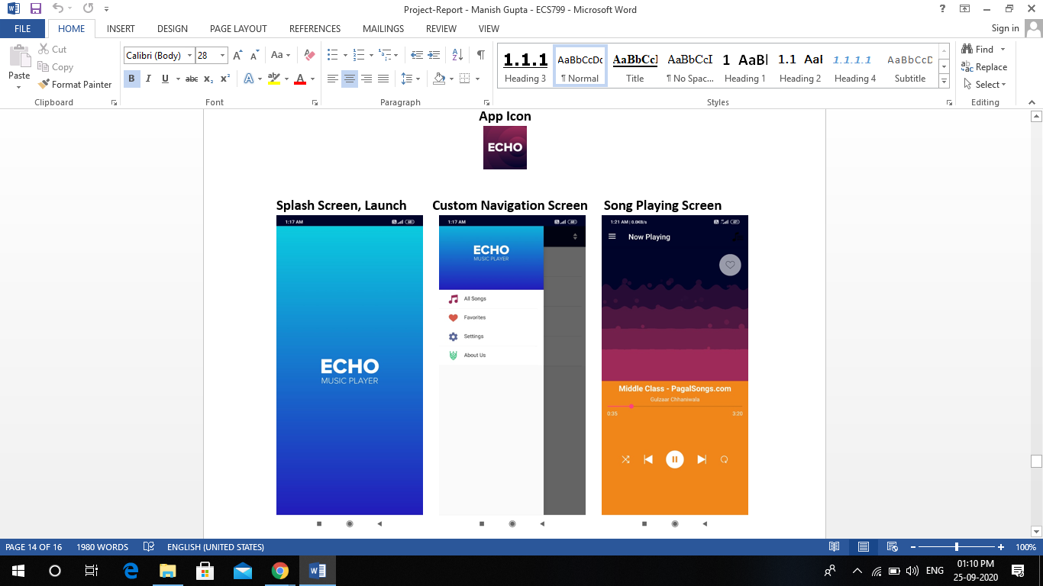
Project Brief
4
T002/ Version 1.0

Slide 5
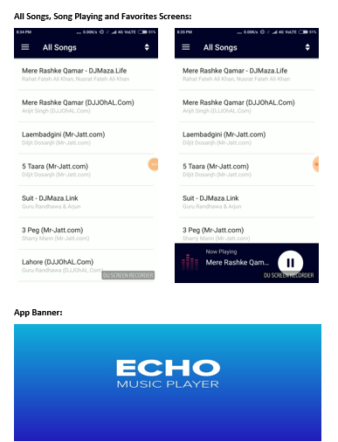
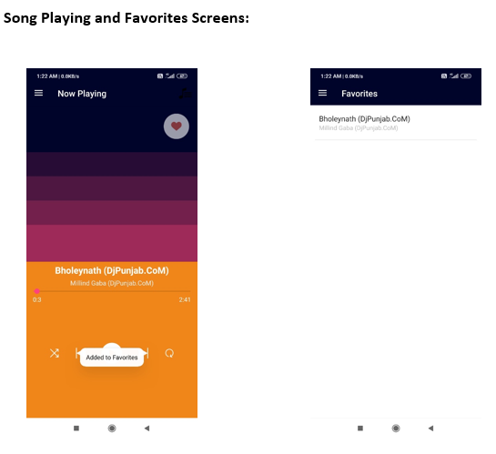
Project Brief
5
T002/ Version 1.0

Slide 6
Technologies and Tools to be used
  Software Platform
Front-end
XML
Back-end
Kotlin
SQLite
Hardware Platform
RAM : at least 256 MB of RAM
Hard Disk : at least 10 MB of Disk Space on Hard Disk
OS : Android Operating System
IDE : Android Studio v1.0
  Tools
Tool Name: Android Studio IDE
Version: 1.0
Developer(s): Google Inc.
Written in: Java, Kotlin, C++
6
T002/ Version 1.0

Slide 7
Context Diagram (Overall Project)
7
T002/ Version 1.0

Slide 8
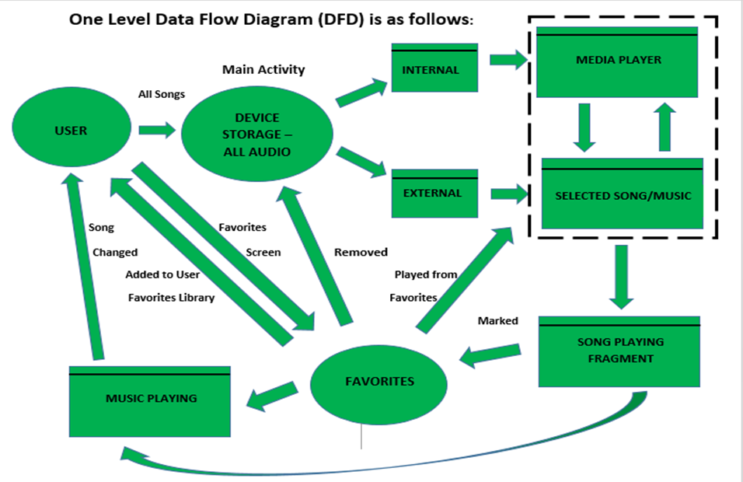
Data Flow Diagram (DFD)
8
T002/ Version 1.0

Slide 9
Advantages of The Project
Shake to Change Functionality : Give your phone a shake to change the playing track
Supports All types of Audio Files
Powerful attention-hacking Open Source Equalizer
Headset/Bluetooth Controls
Create Custom Playlists by Adding your Tracks to Favorites
Smart Remembering feature automatically applies previously Selected Controls
User Friendly - Great UI and UX
9
T002/ Version 1.0

Slide 10
References, if any
a) Books
Android Development with Kotlin by Igor Wojda
Software Engineering Principles and Practices by Roger Pressman
b) Websites
www.google.com
www.trainings.internshala.com
www.youtube.com
www.edx.com
www.stackoverflow.com
10
T002/ Version 1.0

Slide 11

End of Project Synopsis Presentation

